Slide 1
Procedural PHP Session 4
Integration Demo

Slide 2
Coverage
Integration plus:
Session
Password and Hashing
Security
Deploying PHP App
This session will be a full-day follow-my-lead demonstration building a blog site.

Slide 3
Project Planning
Before the beginning of the demonstration, participants shall identify their project, what it is supposed to achieve, and what minimum functions it should have.
From the technical training side, it should have minimum functionalities.
Login form
Session-based security
Multi-role access
Email address validation
Image upload
Database CRUD
HTML5 and Bootstrap
Navigation Bar
Mobile-responsive

Slide 4
Application Technical Requirements
Blog posts can be seen by public users.
Creating post requires registration using active email address and password.
Blog posts can only be edited by the user that created the blog post.
Users can create tags.
User can recover access to account if password is forgotten.
Implement minimum acceptable security practice upon account creation.
When signed in, there is a page that displays the list of posts created by the signed-in user.
The page can allow the user to edit or delete the created posts.
The URL must not show that PHP is used.
Create page listing registered users with number of published posts.
User profile page has a photo, which is uploaded by the user.
Create page for admin to deactivate account.
Public can comment on posts without registering. Full name will be asked upon submitting a comment.
The main section should be 2/3 of the horizontal width of the screen, while the remaining part will be for links to similar next post, according to date of post.
For mobile view, the sidebar is expected to move to the bottom of the page.
The navigation bar is also expected to be mobile responsive.

Slide 5
Basic Steps
Review and organize the requirements into clusters.
Identify the purpose of the system (Ideally, this should be the 1st) – What immediate, intermediate and strategic benefits is the system expected to accomplish or support?
Identify entities and relationships => Database Design.
Identify users and access => Logic
Identify and review procedures => Logic and UI
Document everything
Develop, Test, Revise – Repeat until compliant with Requirements and Purpose
Whenever possible, get the buy-in of the client.

Slide 6
System Development Life Cycle
Identify need for new or enhanced system
Examine information need
Prioritize
Plan
Analyze
Design
Implement
Maintain
Add functionalities based on new requirements
Update the system based on organizational changes
Study org current procedures
Determine specific requirements
Study requirements and structure them according to interrelationships
Code, test, install application.
Train and support users.
Document
Convert recommended solution into logical and physical design system specs

Slide 7
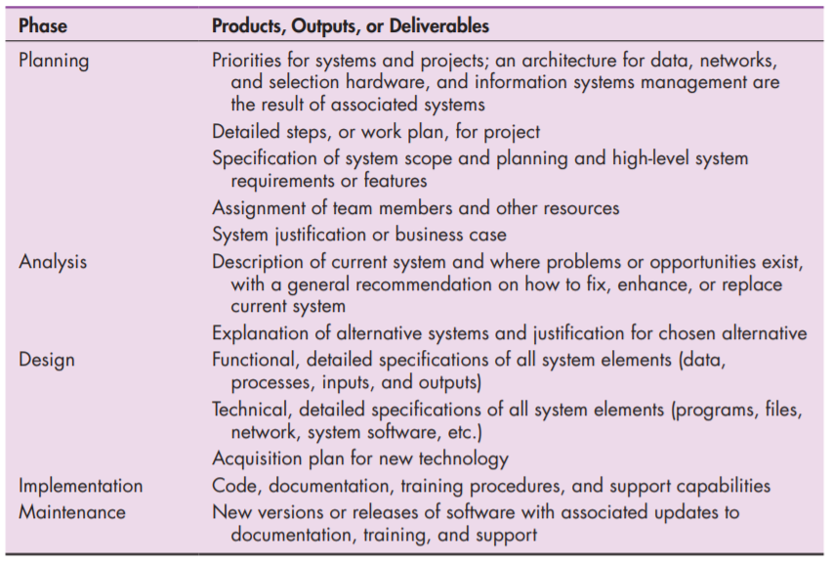

Slide 8
System Development Documentation
Project Profile
Entity-Relationship Diagram or Database Table Definitions
Required Reports
Business Rules (Procedures, Guidelines, Definitions)
Source Code
SQL File
Technical Manual (for future developers who may 0maintain the system)
User Manual (for system administrators, end-users)

